Slide 1

Patient Participation Group
16 June 2022

Slide 2
What is a Primary Care Network (PCN)?
Groups of local practices working together with community, mental health, social care, pharmacy, hospital and voluntary services
Created by the NHS
  People living longer /longer term conditions
  Need to access more services
  Enables proactive care/local impact
  Led by Clinical Directors
1,250 PCNs across England based on GP registered patient lists serving communities of 30,000 - 50,000 people

Slide 3
What is Altrincham Healthcare Alliance?
One of five PCNs across Trafford
Established 2019
Supports more than 48,000 patients
Altrincham Medical Practice
Park Medical Practice
Shay Lane Medical Centre
(Drs Kelman, Cranston, Naylor, Haslam and Connell)
St Johns Medical Centre
West Timperley Medical Centre

Slide 4
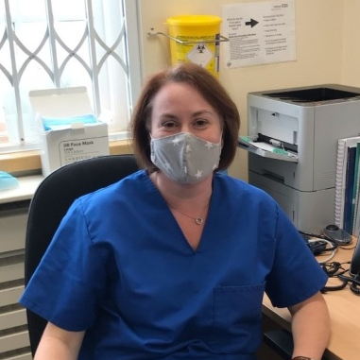
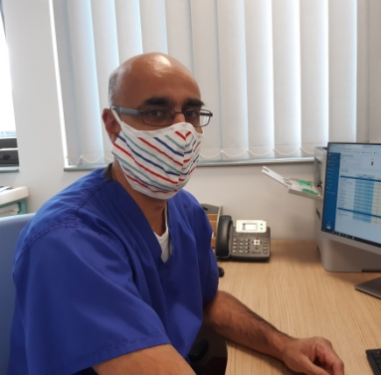
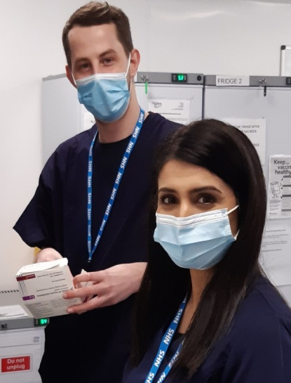
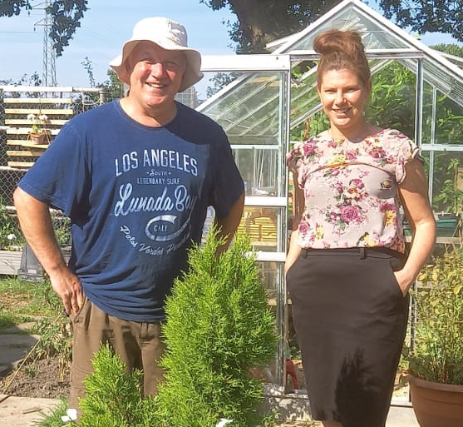
Who’s who?
Clinical Directors
  Dr Kate Jennings and Dr Maz Sangha
Senior Leadership Team
Dedicated workforce including
  Clinical Pharmacists
  Social Prescribers
  First Contact Physios
Notes:
Outline roles of
Clinical Pharms – benefits to patients/what they can help with/how also frees up GPs
Social Prescribers – in brief as more detail on work further on…
FCPs – what they do, how they can help, how they support patients…

Slide 5
A BRIEF SELECTION OF HIGHLIGHTS

Slide 6

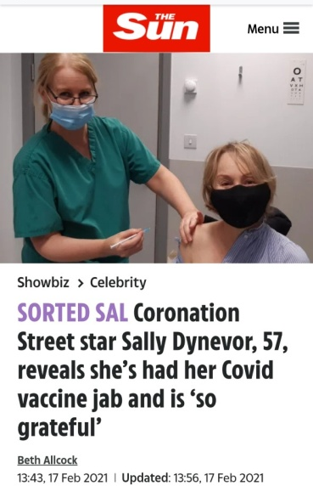
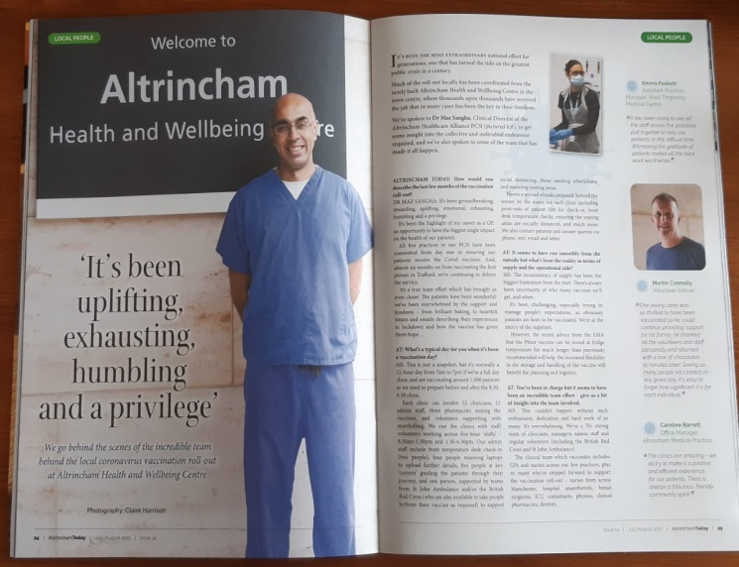
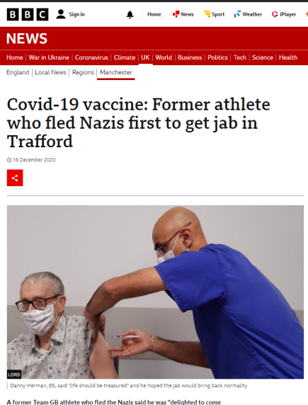
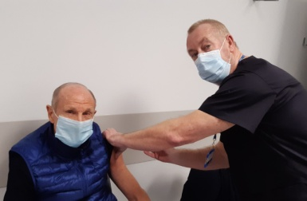
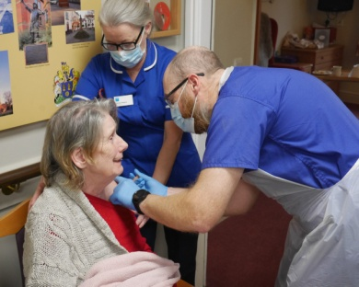
Covid vaccination roll-out
First to deliver Covid vaccinations in Trafford – Dec 2020
Continue to roll-out Covid vaccinations
More than 50,000 vaccinations
Proactive – determined to deliver the best service for patients
Dedicated volunteers/staff across all practices/Red Cross…
Notes:
We led the way with Danny Herman, a Holocaust survivor and patient of St Johns who was the first Trafford patient to receive the vaccine.
We were the PCN to deliver the Covid vaccination service to patients and continue to deliver it locally while other PCN’s handed the service to the large mass-vax sites
More than 50,000 vaccinations – from Primary doses to Boosters, additional vaccinations for those more vulnerable and with particular health conditions, to visiting thousands of housebound patients, to vaccinating our care home patients …
We have been proactive in raising awareness through media stories of those vaccinated – coverage on BBC Radio, BBC TV, ITV, Daily Mail, The Sun, The Mirror, Manchester Evening News, all local channels (from Altrincham Today and the Sale and Altrincham Messenger)
We are the only PCN with a website so this was updated with the ever-changing guidelines plus walk-through videos for those patients not with St Johns and unfamiliar with the Altrincham Health and Wellbeing centre – from highlighting scams, explaining how to use NHS App as proof of vaccine, informing on latest advice. And, as you know we used letters, texts, emails and online sources to you…
Everyone involved in delivering the Covid vaccination programme will tell you that it’s the most humbling and inspiring work they’ve done – hearing people’s tales whether losing loved ones, or loneliness through lockdown, it was a mammoth task and one that brought all our practices together.
Thank you too to all the patients who bought us chocolates/cakes and helped us through – much appreciated and overwhelming.
Plus we were thanked by Prince William…

Slide 7
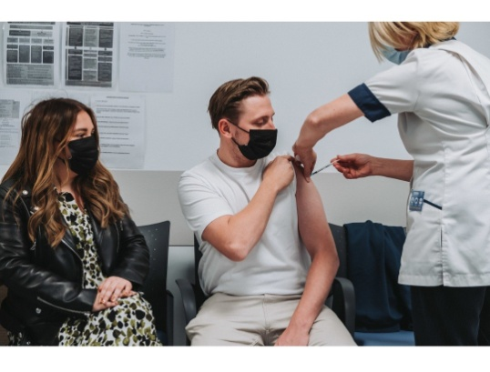
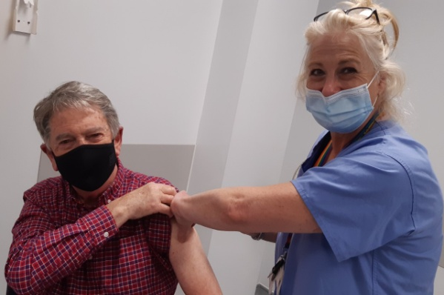
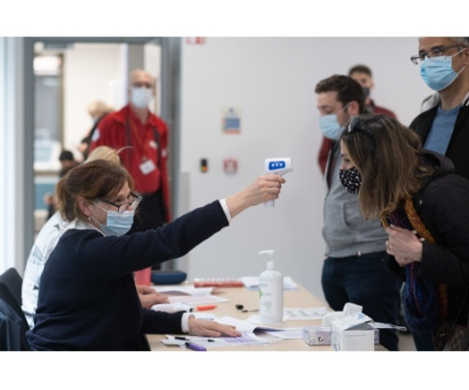
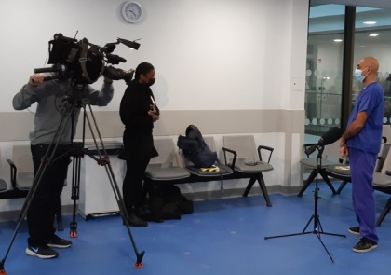
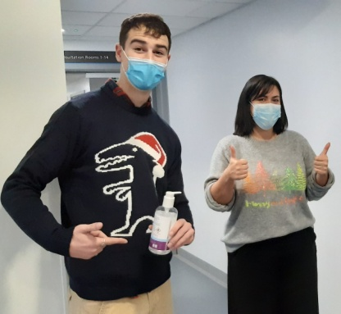
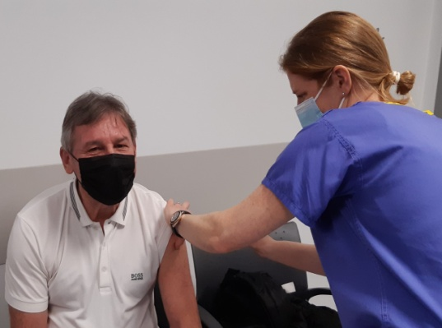
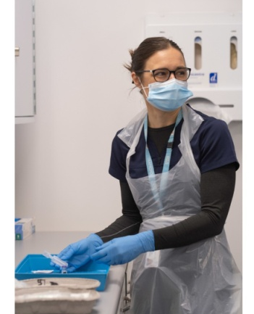
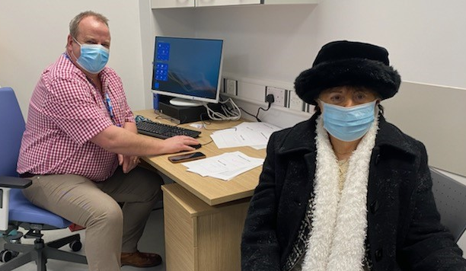
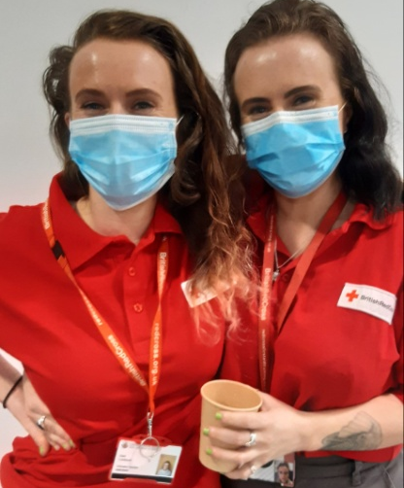
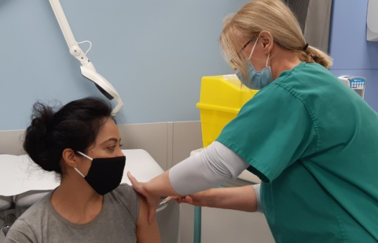
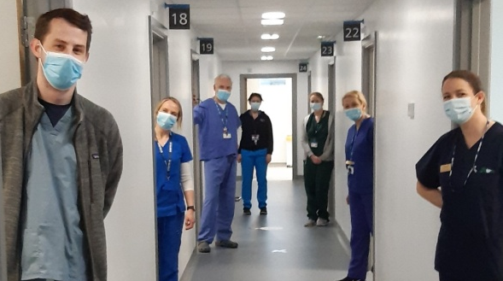
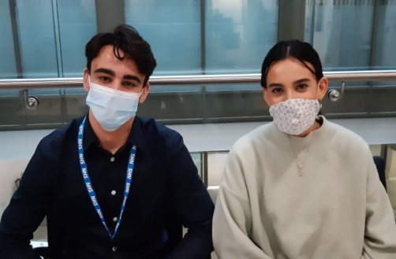
Covid vaccination roll-out
Notes:
A few famous faces – from footballers Bryan Robson, Dennis Tueart, Jack Grealish and David de Gea, to Coronation Street stars, even the Mayor of Trafford as well as help from the Red Cross, St Johns Ambulance…and we were still going on Christmas Eve…
A real family affair…
Strong relationship between GP practice staff in delivering the service
Humbling – examples of patient stories

Slide 8


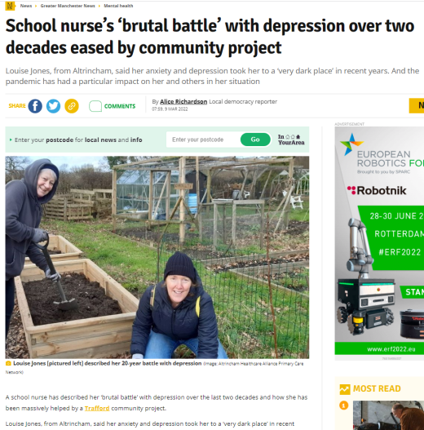
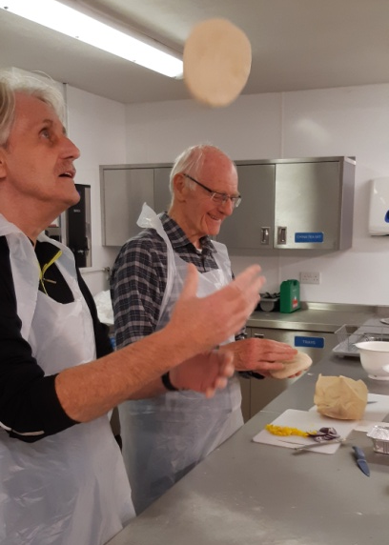
Social Prescribing work
Skills not pills – supporting people with loneliness, anxiety, depression, housing/debt issues…
Covid – wellbeing calls/food and prescription deliveries
Green prescribing – allotment:mental/physical health benefits
Debt service, arts, music, interview prep, Pantastic!
Established in practices – drop in
Self-referral (websites) or via GP practices or email
Notes:
Outline service – how they can help, patient stories, making a difference, benefits, how to refer/reach SPLWs…

Slide 9
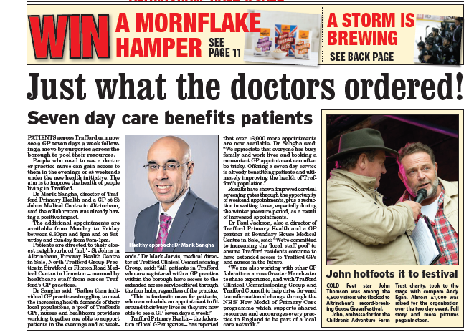
Additional access to GPs
More appointments
  Providing an extra 24 hrs/week – 630-8pm and 9-1pm Sat/Sun
  From 1 Oct – 42hrs/week
Additional clinics
  Phlebotomy, cervical smears, family planning, travel vaccs
We will need your input to shape, maximise and monitor these services
Notes:
Outline offer of additional hours since TPH days – explain benefits (working population able to access in PM and weekends)
Proven success
Outline current demand on Prim.Care/GP Practices and reason behind demand
Anecdotal evid.gathering re. weekend appts in current service v full Sat.

Slide 10
SO WHAT’S NEXT?

Slide 11
YOUR THOUGHTS…

