Slide 1
Clinical Pharmacists in your GP practice
Laura Dewsbery, lead pharmacist

Slide 2
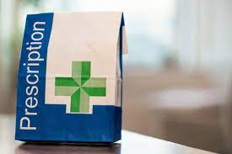
Who we are?
Team of 9 pharmacists working across the 5 GP practices in the Primary Care Network
Each practice has at least one pharmacist working each day
Experts in medication:
Mpharm degree (4 years)
1 year pre-registration year
Independent prescribers
Completed additional training in primary care (18 months)
Continuous professional development
Work closely with GPs and nurses in practice to provide expert medications advice

Slide 3
How do we help patients?
Structured medication reviews (SMRs)
Target groups - highest risk of harm from medications
30 min consultations
Opportunity to ask questions, understand reason for medication and why taking it
597 patients across PCN have had SMRs so far
Aim to do another 380 SMRs by end of March

Slide 4
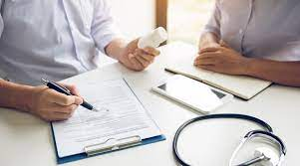
Structured medication reviews (SMRs)
Aims:
Ensure medications are safe
Better care for patients - identify medicines that can be stopped, dosages and/or frequency changed or where new medicines are needed
Reduces overprescribing of medicines and waste.

Slide 5
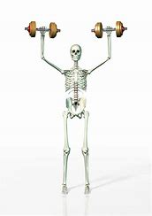
Examples:
Patient prescribed anti-inflammatory medication
Discuss risks and alternatives
If no alternative, prescribe stomach protecting medication to reduce risk
Patient on long term steroid medication
Risk of affecting bones - pharmacist advised scan
Osteopenia identified - calcium and vitamin D prescribed, lifestyle advice
Help reduce risk of fractures in future

Slide 6
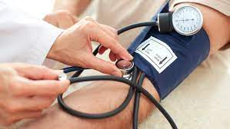
Examples:
Found high blood pressure at review
Confirm on further tests
Start medication to reduce blood pressure
Refer or signpost to other support
Smoking cessation
Alcohol reduction support
Psychological support
Social prescribers

Slide 7
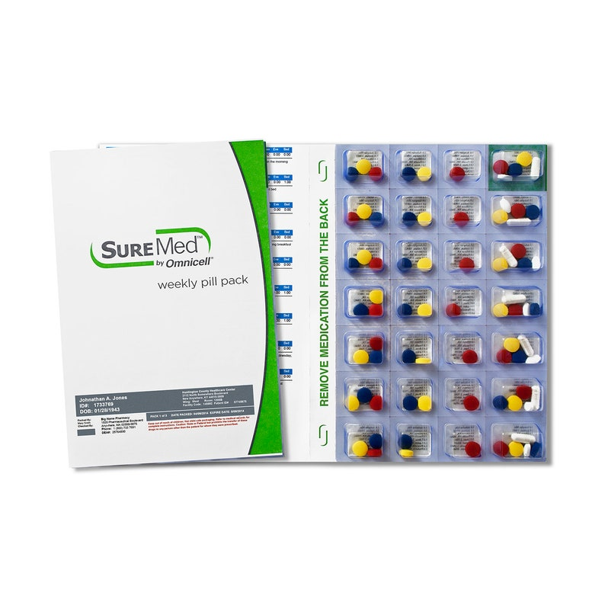
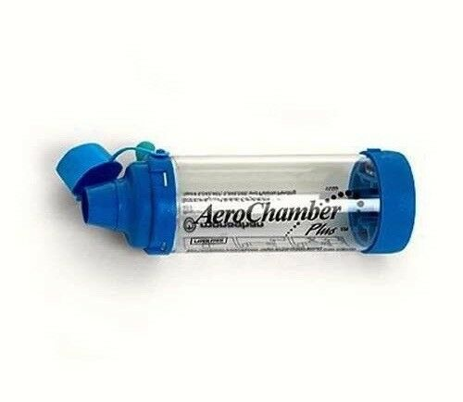
Examples:
Help patients to manage their medications well
Simplify medication regimes
Medication reminder charts
Consider and discuss aids for remembering medication
Eye drop support aids
Blister packs
Spacers for inhalers

Slide 8
How we help patients
Chronic disease reviews:
Blood pressure - new diagnosis and reviews
Cholesterol - heart risk, lifestyle advice and statins if appropriate
Type two diabetes - new diagnosis, lifestyle advice and medications
Hospital discharge and clinic letters
Ensure medications up to date and prescribe new medications
Liaise with hospital colleagues if queries
Ensure patient understand medication changes
Safety monitoring, local prescribing formulary

Slide 9
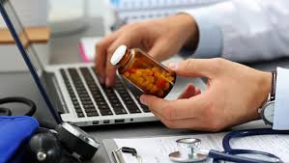
What else do we do?
Patient queries
Concerns about medication - suitability, how to take, side effects
Medication which is out of stock
GP/nurse queries
Which medication is best?
Change formulation of medications where patient can’t swallow
Safety work - audits, alerts
Support practices with work around medication safety

Slide 10
Any questions?

